Slide 1
Modeling Attacks to Chesapeake Bay Shipping
LT Sarah Watson
LT Matt Yokeley

Slide 2
Project Overview
What is this project about?
The goal of this project
The scope of this project
Notes:
What is this project about?
This project is about determining the realistic threat posed to our shipping lanes in the Chesapeake Bay. The majority of US cargo is transported via sea lanes, which means it is one of the largest possible points of attack for terrorists.
The goal of the project
To model the cargo shipped each day on the bay in order to determine the optimal placement of Coast Guard units to intercept a known terrorist threat to prevent a major disruption of cargo flow.
Scope of the project
We modeled the most likely routes of travel that shipping around the bay could take. This includes paths from the three areas that have the most cargo traffic (Baltimore, the Potomac, and Hampton Roads) that ultimately end near the entrance to bay (Chesapeake Lighthouse). The network includes nodes at selected navigational landmarks and points of common travel for shipping. The arcs between each of the nodes represent the approximate tonnage per day of cargo that is sent over these arcs.
Our measure of effectiveness for this project is the total tonnage per day that can ultimately be shipped through the network. Since the number of vessels that traverse daily is hard to quantify and the fact that different ships can carry varying amounts of goods, it seemed logical to focus on the total tonnage, which translates directly into the amount of goods shipped.

Slide 3
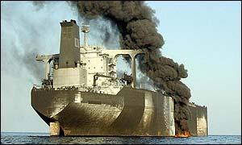
Background
Terrorism continues to threaten international cargo
There is a larger threat to sea born attack than air born
Long term effects of shipping attacks
$
=
+
Notes:
One year ago this month, authorities managed to stop a terrorist threat to transport explosive cargo via air into Chicago. Their ability to interdict these goods was only the result of a last minute tip-off that led to authorities finding the packages with only hours to spare until detonation. While this attempt was made via air traffic, it only reinforces the point that terrorism is still working to wreak havoc and disrupt our daily lives.
We have become accustomed to hearing about such attempts in the wake of the Sepetmber 11th attacks, but what we are less accustomed to considering is the threat to international shipping via the sea lanes. According to the US Army Corps of Engineers, 90-percent of all cargo entering the US comes via the sea and, according to the Center for National Policy, fewer than 1-percent of those goods are scanned abroad for terrorist threats. This means that, contrary to numerous agreements between the US and foreign partners, containers full of goods are not as secure as they should be.
The threat that we are interested in however, deals with the possibility of terrorists directly attacking shipping in an attempt to dsrupt the flow of essential cargo goods to the US. Such attacks are not unheard of either.
On October 6, 2002 al-Qaeda bombers in a small boat filled with explosives rammed the French tanker as it was approaching the Ash Shihr Terminal off the Yemeni coast. The attack killed one crewman and spilled 90,000 barrels of oil from the vessel’s 397,000-barrel cargo. The attack caused insurance premiums for Yemeni ports to triple overnight and container traffic fell by 90-percent. 3,000 jobs were lost as a result and the resulting cost to Yemen was the loss of $15 million per month in shipping revenue.
It is clear from just this one example that a failure to be able to defend against such attacks could result in serious consequences for US ports and this critical link in the supply chain of the US economy.

Slide 4
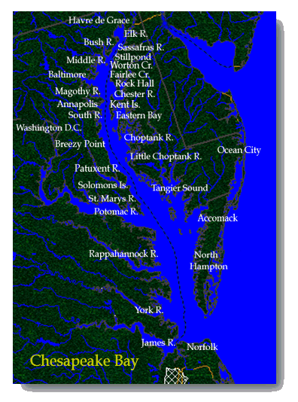
The Network
Chesapeake Bay
Covers 64,299 square miles
More than 150 rivers feed into it
Abstraction
One “dummy” start node
Three supply ports
Ends at Chesapeake Lighthouse
55 arcs

Slide 5
The Model
Built using Max-flow
$\max{V −(1.1×\sum_{ij}{{\overline{x}}_{ij}y_{ij}})} −\left(1e^{−10}×\sum_{ij}{y_{ij}}\right)$
Subject to:
$\sum_{i}{y_{\left(i, start\right)} − \sum_{i}{y_{(start, i)}=−V}}$
$\sum_{i}{y_{\left(i, CL\right)} − \sum_{i}{y_{(CL, i)}=V}}$
$\sum_{i}{y_{\left(i, a\right)} − \sum_{i}{y_{\left(a, i\right)}=0} , ∀ a ≠start, CL}$
$y_{ij}≤max y_{ij}$
Notes:
The basic form of our model is the Max-flow with interdictions. Initially we had a problem with the program using cycles on the undirected arcs to increase the flow, so an additional penalty term was introduced in order to stop this.

Slide 6
The Dual
The dual gave us optimal attack points
$\min{\sum_{i}{y_{ij}}}π_{ij}$
Subject to:
$ρ_{j}−ρ_{i}+π_{ij} ≥0−1.1×{\overline{x}}_{ij}−1e^{−10}$
$ρ_{Start}−ρ_{CL}=1$
$\sum_{ij}{{\overline{x}}_{ij} ≤n}$
Iterated through attacks to find optimal subsequent attacks
Notes:
The basic form of our model is the Max-flow with interdictions. Initially we had a problem with the program using cycles on the undirected arcs to increase the flow, so an additional penalty term was introduced in order to stop this.

Slide 7
Process
Select max number of attackers (x= 1-4)
Determine plan of attack
Remove attacked arcs from list
Find number of CG vessels required to prevent complete network shutdown
Notes:
By selecting a specific number of attackers, we could fix the maximum number of arcs that could be interdicted at any one time.
We then determined what the terrorists best plan of attack was to stop as much tonnage as possible from flowing through the network.
We then removed the attacked arc(s) from the list of potential targets. We determined that we could view the removal of arcs into as the CG protecting the arcs. So by removing it we are saying that there is a CG vessel guarding that specific arc and that there is no possibility of the terrorist being able to attack it, but goods are still allowed to traverse it. This process was repeated until we found a number of CG vessels needed to prevent a complete network shutdown.
Once we had determined how many CG vessels were needed to prevent the network shutdown, we increased the number of simultaneous attackers and repeated the process up to a maximum of four attackers.

Slide 8
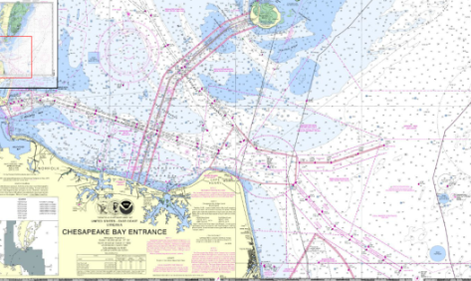
Analysis of One Attacker
Maximum flow of network = 180,235.3 tons
Attackable arcs
Optimal arc for terrorist to attack
Defended arcs
At this point the entire path out of Hampton Roads is protected from attack
Notes:
Here we are modeling the attacker/defender responses to a single attacker. The arcs appearing in red are the “optimal” arcs for the terrorist to hit in order to reduce as much cargo flow as possible. The arcs in blue represent the arcs that are defended by a Coast Guard vessel.
On the graph we can see that given his initial optimal attack, the terrorist is able to stop 123,779.4 tons of goods, thus allowing only 56,455.9 tons of good to actually make it out. We have also graphed the number of arcs attacked each time, which seems trivial, but will prove interesting later.
After we know what the terrorists attack will be, we remove that arc from the list of attackable arcs and consider it defended. Initially we only considered a maximum of five possible defended arcs, but then we decided to increase that amount and as soon as we did, we noticed something interesting happen between five and six defended arcs. At this point the amount of cargo flowing from the network exceeds the amount of cargo the terrorist is actually able to stop. This is a result of the fact that once we have six vessels defending the network, we have completely protected the entire path from Hampton Roads to the sea.

Slide 9
Analysis of Two Attackers
Maximum flow of network = 180,235.3 tons
Attackable arcs
Optimal arc for terrorist to attack
Defended arcs
Notes:
We then increased the number of attackers to two, and modeled how this would make things different. The first thing we noticed was the lack of nesting in the attacked arcs. Since the terrorist has the ability to attack two arcs simultaneously, his entire pattern changed. Instead of attacking in the middle, then working his way back from the beginning, he works his way out from the center.
We also see as a result of this, he is much more effective at being able to stop the flow of goods out of the network. Initially he is able to completely shut off the network with his first two attacks, but as soon as we start defending these arcs, he is no longer able to completely shut it down, and at least some flow is able to get out.

Slide 10
Analysis of Three Attackers
Maximum flow of network = 180,235.3 tons
Attackable arcs
Optimal arc for terrorist to attack
Defended arcs
Notes:
When we increased the number of attackers to three, we noticed yet another change in the attack pattern. This time he starts near the end and works his way back into the bay. We also see that this strategy allows the terrorist to completely stop the flow of goods out of the network up until the point where we have 12 arcs defended. This we found to be very interesting because when there were only two attackers, we were able to ensure flow of goods with only two defenders. By adding just one more attacker, the response required to defend the network increases dramatically.

Slide 11
Analysis of Four Attackers
Maximum flow of network = 180,235.3 tons
Attackable arcs
Optimal arc for terrorist to attack
Defended arcs
The terrorist is able to employ this extra attack as a “reserve” to keep the network down
Notes:
Again when we upped the number of attackers to four, we saw another interesting result. Despite the fact that the attacker has the ability to attack four arcs simultaneously, he doesn’t. He doesn’t attack these points because he doesn’t have to. We should that with only three attackers he could shut down the network, so it is pointless for the terrorist to employ these additional resources until we have 16 defenders in the network. Only when we have this many or more arcs defended does the attacker begin to use his ability to attack four arcs simultaneously.
This gives him a strategic advantage because by being able to employ that one additional resource allows him to continue stopping flow out of the network even with the 12 defended arcs we found when there were only three attackers.

Slide 12
Conclusions
It’s possible to shut down all cargo flow by only attacking two arcs
Attacker/defender ratio is not one-to-one
Compounding increase in goods near the bay entrance causes it to be the major point of concern
What’s next?
Model distance from CG stations to attack points
Use probabilities of attack on arcs
Assign priorities to arcs base d on cargo
Notes:
1- A potential attacker is capable of effectively shutting down all cargo flow out of the bay if they have the capability to attack two transit points simultaneously.
2- Adding one additional attacker, from two to three, caused the number of units required to ensure flow out of the network to jump by a factor of six. Further increasing the attackers from three to four caused the number of required defending vessels to increase by a factor of eight. So it required a significant number of additional resources to ensure the same minimal amount of flow that was achieved with two attackers and two defenders.
3- Essentially the entrance to the bay causes a bottleneck of flow. The amount of aggregated goods from the rest of the network is so high in the Hampton Roads area, that the model doesn’t even consider defending arcs further up in the network until this area is almost completely defended. In a real world scenario, this may be slightly unrealistic and in reality would probably see defending units spread out around the network.
What’s Next??
Look at the response time of units to specific points of attack based on the distance of the arc from a specific CG station. Somehow model the terrorist attacks as a function of time in conjunction with this.
To make it more realistic, the model could be altered to take in probabilities of attack on specific arcs, which could then be used to better model a real world response.
We could assign a priority to specific arcs based on the cargos or the need to get goods from certain locations to another and see how this would affect the attacker/defender responses

Slide 13
Questions??

